Slide 1
Project Presentation– Supply chain Management
Prajwal B Patil

Slide 2
Business Problem Understanding
Objective - To predict the weight of products of a FMCG company for various warehouses with different conditions, size & locality. To determine the Ideal Quantity of Product Weight Shipped to the various Ware Houses of FMCG Instant Noodles Company in order to reduce wastage of the Product, Bridge the Demand – Supply Gap and avoid over-stacking of Products in the Ware Houses.
Scope – To build various linear, non-linear & ensembled models to predict the weight of products of a FMCG company for various warehouses with different conditions, size & locality.
Significance of the project – Demand forecasting also becomes very key as this is the driving force behind the entire process. Effective FSCM aims to create a value chain between the demand and supply, with optimum utilization of all resources.
Constraints (Out of Scope) – No clear information about the distance between the production center & warehouses & sales in retail stores.

Slide 3
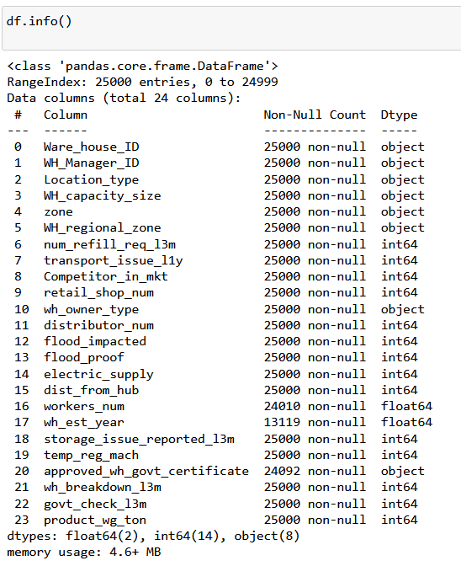
Data Loading and understanding
We started with first Loading the data. As we can see Our data size is 25000 rows x 24 columns.
Data consists of various features which will help us in predicting our dependent variable product_wg_ton
We can find from the info tab that there are some missing values in the data set in wh_est_year, workers_num, govt_check_13m columns
Also some of the columns are of object data type ie :(categorical datatype) and others are int and float datatypes
Moving ahead with correlation analysis.

Slide 4
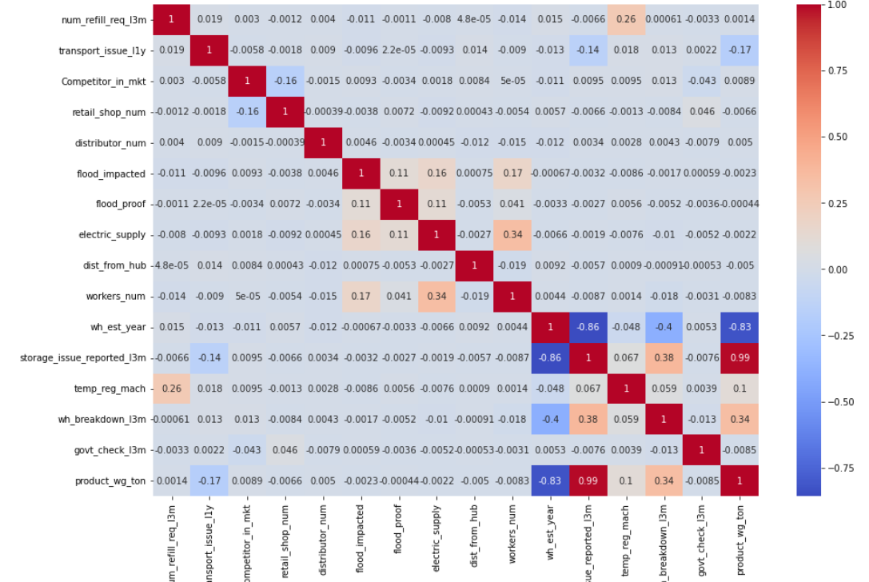
Correlation Analysis
The correlation matrix reveals significant associations between certain features. For instance, a robust positive correlation is evident between the frequency of refill requests and the instances of storage problems reported. This implies that warehouses with more refill request will likely have more storage issues
It's important to emphasize that correlation doesn't imply causation. Merely because two variables are correlated does not mean one directly causes the other. For instance, the strong positive correlation between refill requests and storage issues doesn't prove that refill requests cause storage problems. There could be an underlying third factor that influences both refill requests and storage issues, such as ineffective warehouse management.

Slide 5
Correlation Analysis
Warehouses with a high number of refill requests, transportation issues, and competitors in the market are more likely to have a high number of storage issues reported. Warehouses that are flood-impacted or have unreliable electric supply are more likely to have a high number of storage issues reported. Warehouses that are older or have less temperature-regulated machinery are more likely to have a high number of storage issues reported. Warehouses with more workers or that have been inspected by the government in the past 13 months are less likely to have a high number of storage issues reported.

Slide 6
Insights from Analysis – EDA
Exploratory Data Analysis
Unwanted variables – Warehouse ID, Manager Id and Warehouse established year were removed as they don’t add value to the analysis.
Missing values – Workers_num and approved_certificate has missing values. They were imputed using median and mode respectively.
Encoding –Label encoding were used for Linear and Non-linear models respectively.
Variable transformation – The data types of categorical variables were converted into categorical codes for modeling purpose.

Slide 7
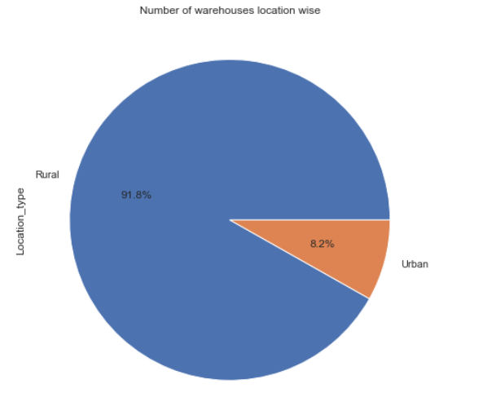
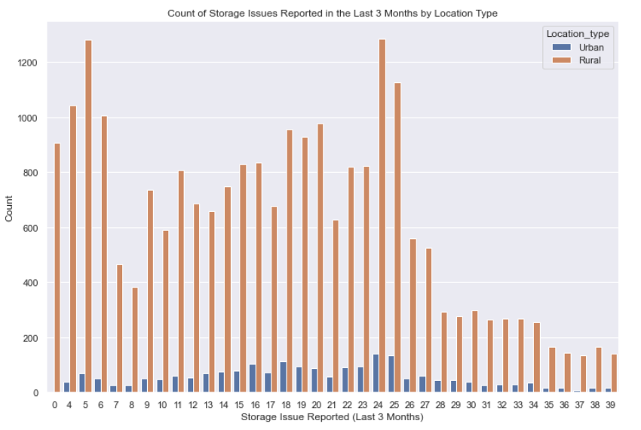
Most of the storage issues can be seen in the Rural area. As Rural areas are more prone to transport, rat’s, fungus and all he other factors
Majority percent of warehouses are located in Rural Areas.

Slide 8
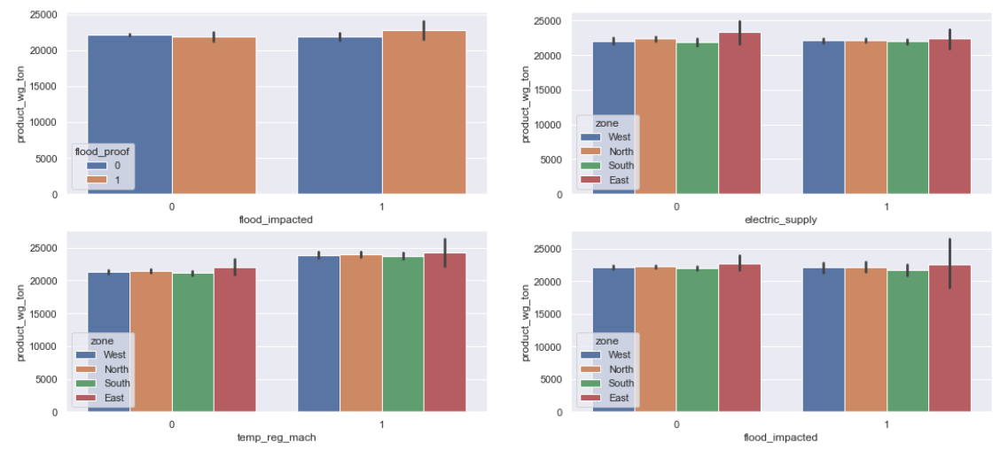
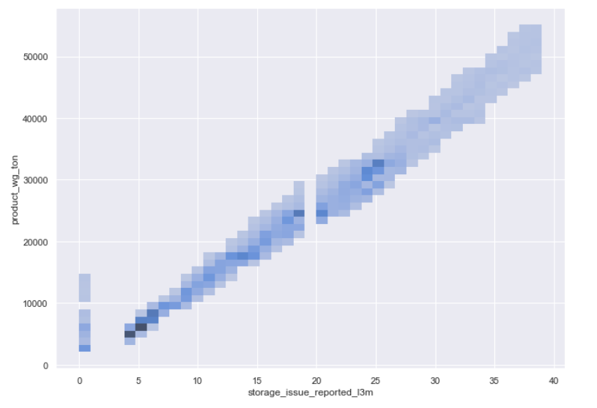
Univariate and Bivariate Analysis
Storage issues reported is in linear relationship with the weight of the product shipped.
Products are shipped in flood impacted areas despite not having flood proof.
Almost same amount of products are shipped to zones that don’t have electric backup and Temp regulator machines.
22,000 tons of product shipped in flood impacted zones across all regions.

Slide 9
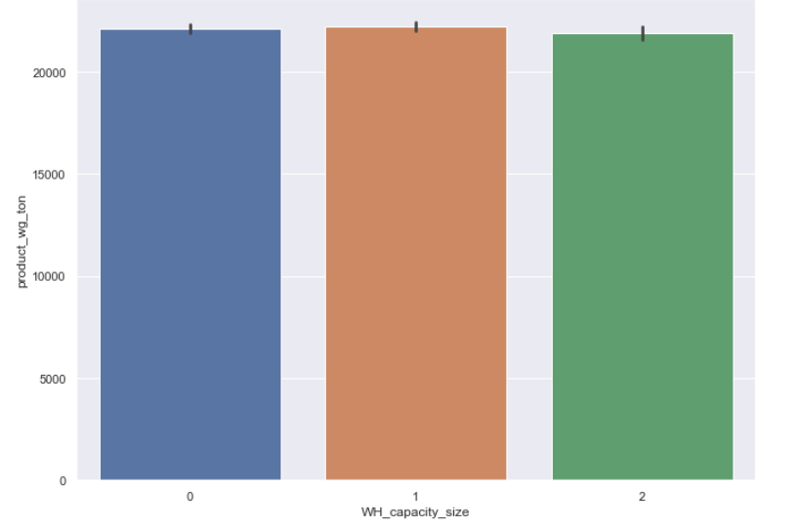
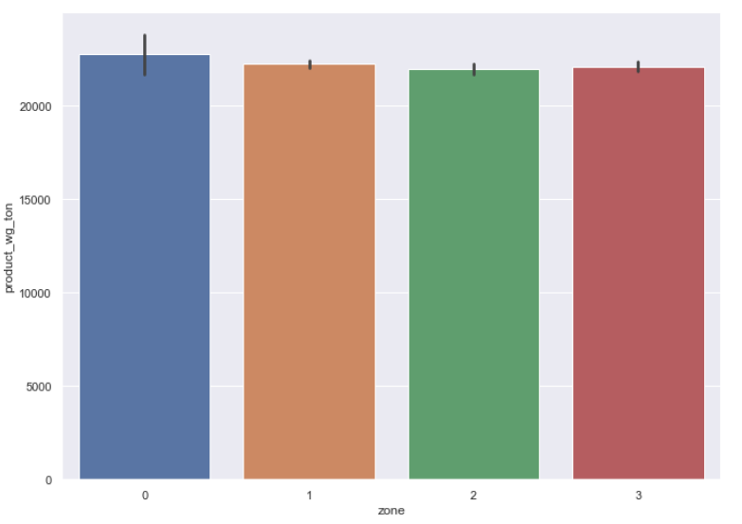
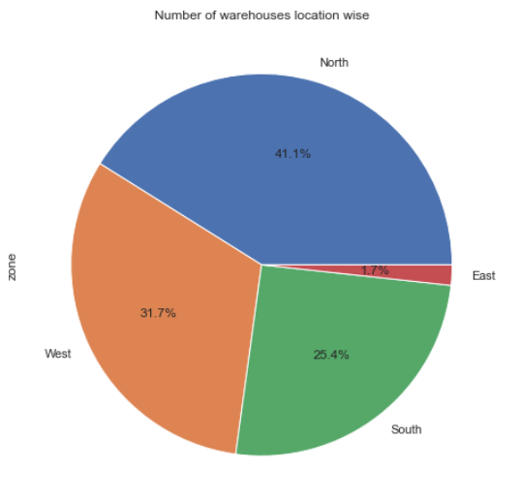
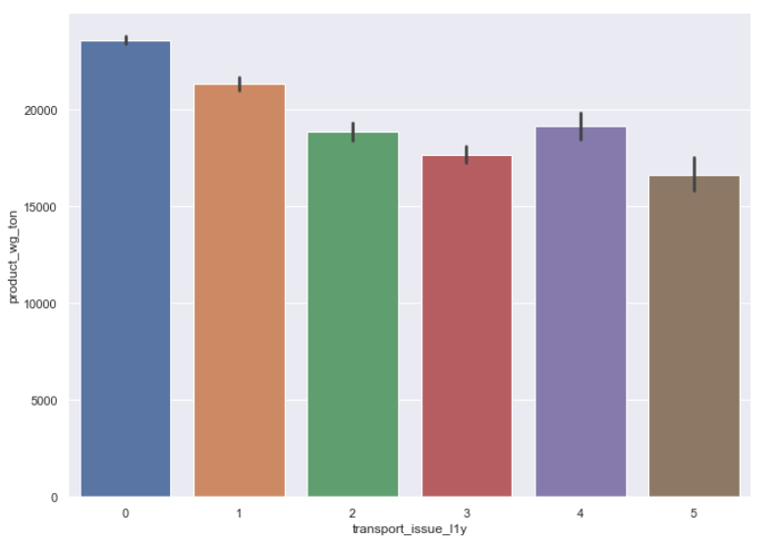
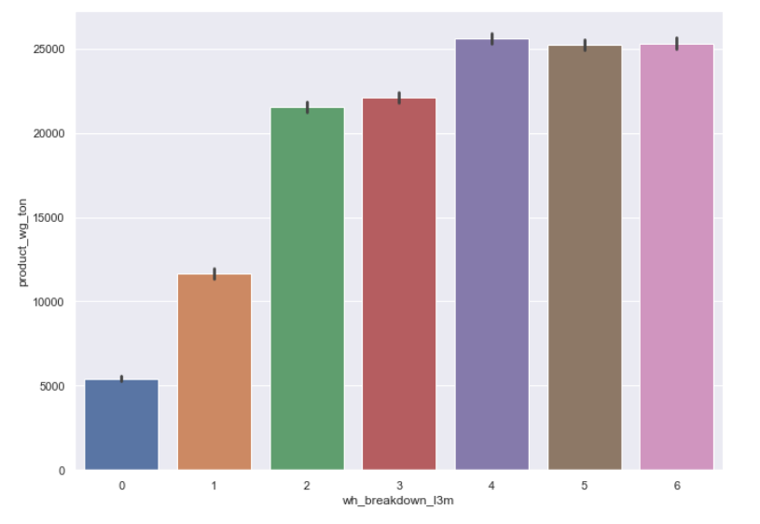
Almost same amount of products are shipped across all regions irrespective of their capacity and number of warehouses.
More than 15000 tons of products are shipped to warehouses that have reported transport issues.
Warehouses that have reported higher number of breakdowns are supplied the highest amount of products as well.

Slide 10
Modelling Approach Used – What & How?
Linear Models
Linear Regression - Simple & Most popular. But impacted by multicollinearity & outliers
Non-linear & Ensembled Models
Random Forest Regression - achieves extremely high accuracies, not sensitive to null values and outliers.
Gradient Boosting Regression – Better predictive accuracy, handles missing data but memory exhaustive due to hyper tuning.

Slide 11
Model (Cross validation score) | R2 | RMSE | MSE
Linear (Train) | 97.68 | 1760.35 | 3098855.763
Linear (Test) | 97.77 | 1727.61 | 2984645.970
Random Forest (Train) | 99.30 | 357.64 | 127907.327
Random Forest (Test) | 99.24 | 943.16 | 889552.503
Gradient boosting (Train) | 99.34 | 922.58 | 851159.836
Gradient boosting (Test) | 99.33 | 920.20 | 846786.130

Slide 12
Recommendations
From models gradient boosting being the best model, the feature importance of variables were calculated.
It is found that storage issues reported has the highest significance among all models with the predictor variable. More products should be shipped to warehouses having less storage issues which also depends on the capacity. LESS CAPACITY = MORE STORAGE ISSUES
Warehouses that have temperature regulators and less number of breakdowns should be shipped more products to avoid spoilage.
More products to be shipped to warehouses that have reported less transport issues which also has an effect on number of refills. LESS NO OF REFILL = LESS TRANSPORT ISSUES AND REDUCED TRANSPORTATION COST
Cut down labour count in small warehouses. Shortage of workers in large warehouses might lead to low maintenance or labour strike (Warehouse Breakdown)
Increase products to be shipped in rural areas as there is demand (equal no of retail shops) also keeping transport issues and other facilities in check.

Slide 13
THANK YOU

